Slide 1
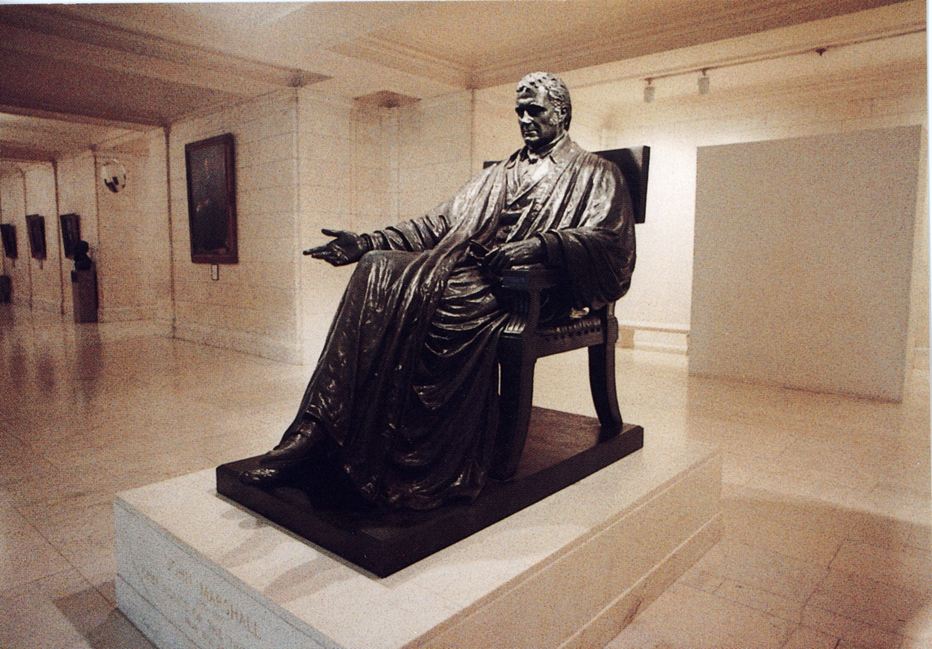
John Marshall
1
8
0
1
Served as John Adam’s Secretary of State
Chief justice of the United States from 1801 to 1835.
A Federalist
His court issued several significant decisions including those in Marbury v. Madison and McCulloch v. Maryland.
He is the one who made the judicial branch co-equal to the other branches
He was the “keeper” of the Hamiltonian vision during the era of Jefferson

Slide 2
Background
Served in the Revolutionary Army for four years and suffered through Valley Forge with George Washington, whom he adored.
Served in the Virginia legislature (1783-89) when Virginia planters refused to pay their debts to English merchants.
Served in VA legislature when Daniel Shays led his rebellion, the country experienced economic depression and European disrespect

Slide 3
Background
Bloody tales of the French Revolution filtered across the Atlantic to America. Many Americans believed the situation in France had become chaotic.
President Washington had been attacked because of the Proclamation of Neutrality in 1793, his actions to suppress the Whiskey Rebellion, and his acceptance of the unpopular Jay Treaty

Slide 4
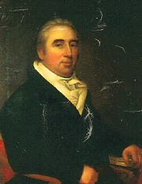
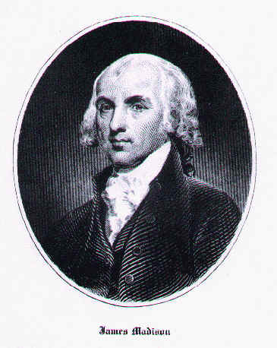
Marbury v. Madison

Slide 5
Marbury v. Madison
The time was 1800.

Slide 6
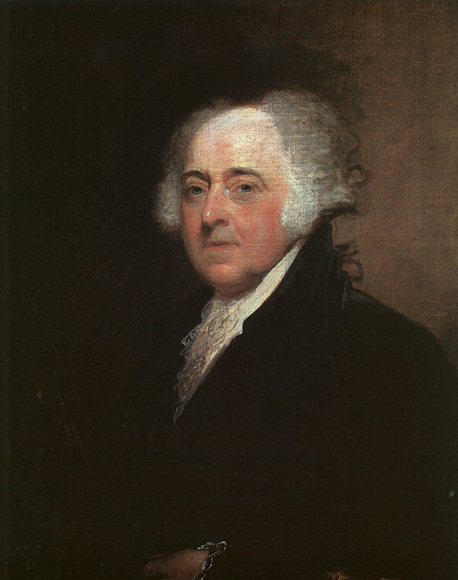
Marbury v. Madison
John Adam (a Federalist) lost his presidential re-election bid…

Slide 7
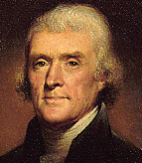
Marbury v. Madison
…to Thomas Jefferson (a Democratic-Republican), who won the Election of 1800

Slide 8
Marbury v. Madison
Jefferson was to be inaugurated on March 4, 1801.

Slide 9
Marbury v. Madison
Adams was not happy over his defeat.

Slide 10
Marbury v. Madison
Before leaving office, Adams worked with his political supporters in Congress…

Slide 11
Marbury v. Madison
…to keep control of the federal courts and as many other offices as possible.

Slide 12
Marbury v. Madison
How do you think he did this?

Slide 13
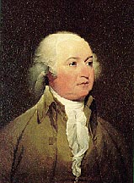
Marbury v. Madison
At the “eleventh hour,” Adams appointed (and the Senate confirmed)…

Slide 14
Marbury v. Madison
…all 16 federal circuit court judges provided for in the Judiciary Act of 1801.

Slide 15
Marbury v. Madison
Their objective was to fill all judicial positions with Federalist friends.

Slide 16
Marbury v. Madison
That way the Federalists would maintain control over the judiciary.

Slide 17

Marbury v. Madison
On his last night in office, Adams was busily signing off on judicial appointments.

Slide 18

Marbury v. Madison
These were the so-called “midnight judges.”

Slide 19
Marbury v. Madison
And who was responsible for delivering the signed commissions?

Slide 20
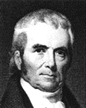
Marbury v. Madison
John Adams’s Secretary of State, John Marshall, a Federalist

Slide 21
Marbury v. Madison
William Marbury was one of the 42 justices of the peace appointed to the District of Columbia.

Slide 22
Marbury v. Madison
Unfortunately, Marbury’s appointment was among a few that were signed and sealed…

Slide 23
Marbury v. Madison
…but never delivered before Adams’s term came to an end.

Slide 24
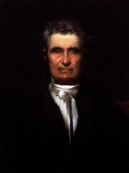
Marbury v. Madison
Meanwhile, John Marshall was appointed as Chief Justice of the Supreme Court.

Slide 25
Marbury v. Madison
When Jefferson took office, he refused to recognize Marybury’s appointment…

Slide 26
Marbury v. Madison
…because it was never delivered (and he wanted as few Federalists in the judiciary as possible).

Slide 27
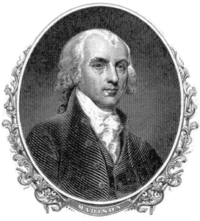
Marbury v. Madison
Meanwhile, Jefferson appointed his friend and fellow Virginian, James Madison…

Slide 28
Marbury v. Madison
…as Secretary of State.
He also ordered him not to deliver Marbury’s commission.

Slide 29
Marbury v. Madison
So, Marbury appealed to the Supreme Court for a court order demanding his appointment be delivered to him.

Slide 30
A writ of mandamus
A writ of mandamus is an order from a court de-mand-ing that a government official execute his proper duties.

Slide 31
Marbury v. Madison
The basis for his appeal was that the Judiciary Act of 1789 gave the Supreme Court the power to order the Secretary of State (Madison) to give Marbury the promised appointment.

Slide 32
Marbury v. Madison
In December, 1801, James Madison was directed by the Supreme Court to show cause why a writ of mandamus should not be issued.

Slide 33
Marbury v. Madison
Jefferson responded by having his Republican friends in Congress revoke the Judiciary Act of 1801.

Slide 34
Marbury v. Madison
In so doing, they eliminated the 16 judgeships created by the Act.

Slide 35
Marbury v. Madison
Then the Republican Congress passed the Judiciary Act of 1802.

Slide 36
Marbury v. Madison
This Act established one annual Supreme Court term beginning in February

Slide 37
Marbury v. Madison
The practical effect was to cancel a scheduled June and December term for the Court…

Slide 38
Marbury v. Madison
…putting the Supreme Court out of action for a year and delaying arguments in Marbury’s case.

Slide 39
Marbury v. Madison
Poor William Marbury waited two years and still did not receive his appointment.

Slide 40
The Court faced a dilemma…
The Jefferson administration declared Adams’s justices of the peace for DC invalid.
They would probably refuse to recognize a Court order to deliver Marbury’s commission.

Slide 41
The Court faced a dilemma…
It also faced a Congress hostile to a Federalist-dominated judicial branch.
The Court, the weakest of the three branches, could essentially destroy itself by choosing the wrong course of action.

Slide 42
The Court faced a dilemma…
If it ruled in Marbury’s favor, it would show its weakness by issuing an order that the executive branch would ignore.
If it denied Marbury’s claim, it would risk the appearance of “giving in” to Congress’s threatened power.

Slide 43
Marbury v. Madison
Enter John Marshall, Chief Justice of the Supreme Court, Federalist and
…a very shrewd man.

Slide 44
Marbury v. Madison
The case went to the Supreme Court in February, 1803.

Slide 45
Marbury v. Madison
Marshall declared that Marbury had a right to his appointment as justice of the peace, but…

Slide 46
Marbury v. Madison
The Judiciary Act of 1789 (particularly the part that said the Supreme Court had the right to issue orders (such as in Marbury’s case) was unconstitutional.

Slide 47
Marbury v. Madison
In other words, the Judiciary Act of 1789 gave the Supreme Court powers that were not granted to it by the U.S. Constitution.

Slide 48
Marbury v. Madison
Therefore, there was nothing they could do about enforcing Marbury’s appointment.

Slide 49
Marbury v. Madison
Why was this a brilliant decision?

Slide 50
John Marshall’s Decision
Managed to recognize the legitimacy of Marbury’s claim…
while denying the Supreme Court’s power to give Marbury the remedy he sought, thus...
avoiding a unwinnable confrontation with the executive and legislative branches.

Slide 51
John Marshall’s Decision
While at the same time chastising the Jefferson administration for refusing to deliver the appointment, and…
Declaring the power of the Supreme Court to rule provisions of Congressional law unconstitutional.

Slide 52
John Marshall’s Decision
Marshall managed to confound his opponents by limiting the Court’s power in the Marbury matter, but…
Asserting a much more important and far-reaching power, which is known as..

Slide 53
Marbury v. Madison
JUDICIAL REVIEW—the power of the Supreme Court to rule laws unconstitutional

